Slide 1

Web Development 1
© Hugh McCabe & Matt Smith 2008-2014
Lecture 3b
HTML – Links

Slide 2
Introduction
This week we are going learning how to add an important features to web pages:
hypertext links
This allows us to make sites, comprising of multiple interlinked pages, and also link to pages on other web sites on the WWW
Plus we’ll learn a bit more about images …

Slide 3
Adding Links - Introduction
If you are creating a page for the web, chances are you will want it to link somewhere.
These are the main examples of where to link:
Link to another page of your site
Link to a page on someone else’s site
To create a link we use the anchor element, a
I know, this is a terrible name … but at least it’s short ☺
This comprises of an opening and closing tag e.g.
<a> ... </a>

Slide 4
Adding Links - Introduction
The content of this element becomes the hypertext link
Wrap some text in opening and closing <a>…</a> tags and use the href attribute to provide the URL of the linked page.
For example:
<a href="http://www.itb.ie">ITB</a>
This links to ITB’s website
Appear in browser as text “ITB”, blue and underlined
if no other style rules are applied to the page

Slide 5
Adding Links - Introduction
Can use IMAGES as content for links
Or mixture of images and text
There is NO restriction on what can be the content inside an anchor link element
Text
Images
Mixed text and images
Block level elements like paragraphs etc.

Slide 6
The href Attribute
The href attribute provides the address (URL) of the page we want to link to.
The URL must always be in quotation marks.
In fact, the values of all attributes should be in quotation marks – KISS (Keep is Simple …)
(this is best practice, since it means you don’t have to worry about when they MUST be used and when they are optional …)
Most of the time we link to other HTML documents.
But, we can also link to resources such as images, video files, audio and so on.
There are two different ways to specify the URL.

Slide 7
Absolute URLs: link to another website
Absolute URLs
These provide the full URL for the document
This includes:
The protocol (http://)
The domain name
The pathname
You have to use the absolute URL when pointing to a page that is out on the Web.
For example:
href="http://www.alistapart/index.html"

Slide 8
Relative URLs: link to another page on same website
Relative URLs
These describe the pathname to the linked file relative to the current document.
No protocol, no domain name. Just use the pathname.
Relative URLs are used when linking to pages on your own site (i.e. on the same server)
For example:
href="about.html"
href="contact.html“
Can also link to sub-folders …
href="courses/computing.html”
(but don’t use sub-folders in your project please – KISS)

Slide 9
Absolute URLs: Linking to Pages on the Web
A link to a page on another site called an external link.
Have to use absolute URL for this, which includes:
protocol http://
Site name www.itb.ie
Pathname /courses/computing.html
The next slide contains some HTML code with some examples of external links.
The slide after that shows them rendered in a browser.

Slide 10
Linking to Pages on the Web
<!DOCTYPE html>
<html><head>
<meta charset="utf-8”>
<title>Links Example</title>
</head>
<body>
<p>
An example of a good site about web design and development is
<a href="http://www.alistapart.com">A List Apart</a>.
</p>
<p>
It contains information on all sorts of topics, including:
</p>
<ul>
<li><a href="http://www.alistapart.com/topics/code">Code</a></li>
<li><a href="http://www.alistapart.com/topics/content">Content</a></li>
<li><a href="http://www.alistapart.com/topics/design">Design</a></li>
</ul>
</body>
</html>

Slide 11
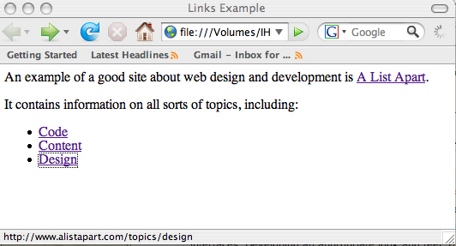
Linking to Pages on the Web

Slide 12
Linking Within Your Own Site
Most linking will be to pages within same site
In these cases, we use a relative URL
one that calls for a page within your own server
you do NOT specify the protocol for relative URLs
browser looks for file on current server
i.e. same server as webpage in which link is written
VERY simple, if website designed carefully, e.g.:
index.html
about.html
contact.html
products.html
Plus folders /images and /css

Slide 13
Simple website structure
Sub-folder for images
Sub-folder for CSS style sheets
All HTML pages in main website folder
/site
index.html
about.html
contact.html
/images
/css
mystyle.css
logo.png
product1.jpg

Slide 14
Relative URLs: Linking within same directory/folder
Simplest relative URL is when we want to link to another file within same directory/folder
Just write filename of file to link to
For example, if want to link from index.html to the file about.html.
Both files are in the same directory.
So, the link inside index.html would be as follows:
<a href="about.html">About this page</a>
See diagram on next slide

Slide 15
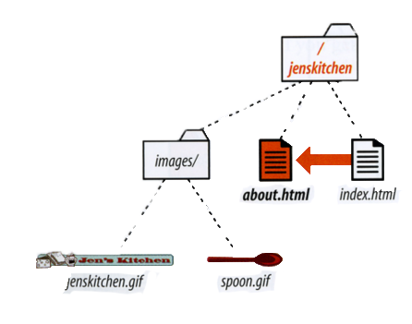
Linking Within Your Own Site
This code in index.html makes the text “About this page” a link to page about.html:
<a href="about.html">About this page</a>

Slide 16
Images as Links

Slide 17
Images as links
To make an image a link simply add an anchor <a> element around your image
E.g.
<a href="index.html"><img src="house.gif" alt=""></a>
That’s it !
NOTE: have no space between >< or you’ll get spaces as links too… This is one time where SPACES matter a lot !!!!!!!!!!!!!!!!

Slide 18
eMail Links

Slide 19
eMail Links
Here’s something handy.
Can use mailto protocol to put link to email address appearing in web page
When user clicks email link, their email program will boot up with new mail message started to that email address
If device web page being viewed on has an email application …
E.g.
<a href="mailto:hugh.mccabe@itb.ie">
Contact Hugh
</a>

Slide 20
Summary and Conclusions

Slide 21
Summary / Conclusions … links/images/email
Linking to page on basic site easy: relative URL
Just give file name (if all HTML in main website folder)
Link to file on different website: absolute URL
Need to write protocol, sitename, and path & file
Can turn anything into a link
Text, images, text and images, headings etc.
Can define a mailto: link
So new email message pops up when clicked

Slide 22
Complex paths – to current and parent folder using dot and double-dot

Slide 23
Paths to current/parent folder - dots (KISS – no need for this if you have simple folder structure
Sometimes (perhaps an ‘inherited’ site you have to maintain) you may have to work with HTML pages in sub folders
When writing relative or absolute paths to page or image resources etc. there are 2 special folders:
The folder in which the webpage you are writing appears
. (yes – just a single full stop)
The ‘parent’ to the current page’s folder
. . (yes – just 2 full stops)
So if a page “licence.html” was in a subfolder “bits”, it could make word “home” link back up to the parent folder using the 2 dot notation in the path:
<a href="../index.html">home</a>

Slide 24
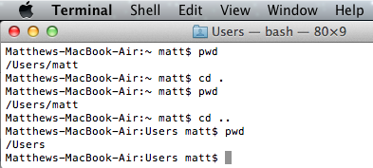
You’ll see “.” and “..” used in command line OS interactions, to navigate directories
Above we can see how cd (change directory) to “.” keeps us in the SAME directory (folder)
And changing to “..” moves us to the parent directory
Try it in DOS Windows - Start | CMD

